Slide 1


M.Tech/MCA Program
Advanced Industry Integrated Programs
Jointly offered by University and LTIMindTree
Review III
AI Voyage Panner-Context Aware Travel Recommendations and Adaptive Scheduling
Syed Ali Fathima S
M.TECH(AI&DS)|B.S.A.CRESCENT INSTITUTE OF SCIENCE AND TECHNOLOGY|T9957
Knowledge partner | Implementation partner

Slide 2
Project Title - AI Voyage Planner
Introduction
Planning a trip manually requires searching multiple sources for destinations, attractions, restaurants, hotels, weather, and routes.
Generic travel plans may not consider the user's budget, interests, travel dates, number of travelers, and food preferences.
AI Voyage Planner uses Generative AI, RAG, and live location-based APIs to create personalized travel plans.
The system integrates Geoapify, OpenWeather, and route information to provide dynamic travel recommendations.
A React frontend and FastAPI backend are used to provide an interactive travel planning platform.
The system aims to make travel planning personalized, structured, and data-driven.

Slide 3
Project Title - AI Voyage Planner
Objective
To develop an AI-based personalized travel planning system.
To generate day-wise itineraries based on destination, duration, budget, interests, and number of travelers.
To retrieve real-world tourist places and restaurants using Geoapify APIs.
To provide weather information using the OpenWeather API.
To generate route information between the origin and destination.
To recommend hotels, restaurants, attractions, and local places.
To dynamically replan the itinerary based on changing user requirements.
To provide a user-friendly web interface using React and FastAPI.

Slide 4
Project Title - AI Voyage Planner
Module name
S.No | Module Name | Description
1 | User Input | Accepts origin, destination, dates, travelers, budget and interests
2 | Destination Processing | Identifies and processes the selected destination
3 | Live Places Retrieval | Retrieves real tourist places using Geoapify
4 | Restaurant Recommendation | Provides breakfast, lunch and dinner recommendations
5 | Weather Information | Retrieves destination weather information
6 | Route Planning | Calculates route and distance between origin and destination
7 | Smart Itinerary Generation | Creates morning, afternoon and evening activities
8 | Hotel & Local Place Recommendation | Displays available hotels and local places

Slide 5
Project Title - AI Voyage Planner
Problem Statement
Travel planning requires information from multiple platforms.
Users need to manually compare destinations, attractions, restaurants, hotels and transportation.
Existing travel planners often provide generic itineraries instead of highly personalized plans.
Static travel plans cannot easily adapt when user requirements change.
Live information such as weather, routes and nearby places must be obtained from external sources.
Therefore, there is a need for an AI-powered travel planner that combines personalization, retrieval, live APIs and dynamic itinerary generation.

Slide 6
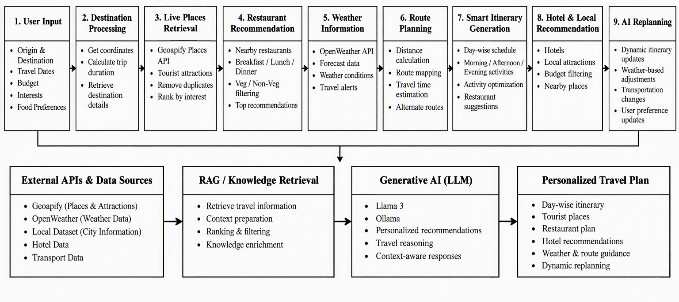
Project Title – AI Voyage Planner
Methodology

Slide 7
Technology Stack
Layer / Category | Technology / Library | Role & Functionality | Detailed Explanation / Why It Was Used
Frontend Framework | React 19 | Core UI Component Architecture | Manages component lifecycles, dynamic UI state (day tabs, filter states, itinerary edits), and reactive view updates without full page reloads.
Build Tool & Bundler | Vite 8 | Development Server & Production Bundler | Provides lightning-fast Hot Module Replacement (HMR) and optimized build bundling for high performance.
Client Routing | React Router DOM v7 | Client-Side Page Routing | Handles navigation between the Landing page (/), Trip Configuration form (/plan), and Itinerary Results (/results).
Styling & Design System | Vanilla CSS + Glassmorphism | Custom Design System & Responsive Layout | Custom, high-performance CSS system featuring dark mode aesthetics, frosted glass blur effects, smooth micro-animations, and responsive mobile-first grids.
Icons & Visuals | Lucide React | Scalable Vector UI Icons | Delivers lightweight, modern UI icons for weather conditions, meal categories, transport modes, and navigation pins.
Backend Framework | FastAPI (Python 3.10+) | High-Performance REST API Engine | Asynchronous, lightweight backend framework exposing fast endpoints (/api/plan-trip, /api/route, /api/places, /api/replan).
ASGI Web Server | Uvicorn | High-Concurrency Server | Asynchronous server implementation running the FastAPI application with multi-client worker support.
Data Validation | Pydantic | Request & Response Schema Validation | Enforces strict type checking, sanitization, and data validation on user travel input payloads.
Generative AI & LLM | Google Gemini AI (gemini-pro / gemini-1.5) | Itinerary Synthesis & Dynamic Replanner | Generates personalized, cohesive daily itineraries and dynamically adapts plans when disruptions (bad weather, traffic) occur.
RAG & Semantic Retrieval | Sentence-Transformers & ChromaDB / Custom Embeddings | Retrieval-Augmented Generation (RAG) | Encodes travel POI metadata into high-dimensional vector embeddings for fast semantic similarity search and relevance ranking.
Geospatial & Mapping API | Geoapify APIs | Geocoding, Routing, Places & Static Maps | - Places v2: Live POIs, dining spots, attractions. - Routing API: Live polylines, travel distance, and duration. - Static Maps v1: Generates centered, subcontinent-wide India route maps.
Weather Forecast API | OpenWeatherMap API | Real-Time & 5-Day Weather Intelligence | Retrieves live temperatures, precipitation risks, and weather alerts to ensure outdoor safety and guide indoor/outdoor scheduling.
Spatial Calculations | Geopy & Haversine Algorithm | Proximity Validation & Distance Checks | Calculates Great-Circle distances to enforce strict $\le 40\text{ km}$ destination proximity checks and $\le 25\text{ km}$ restaurant boundaries.
Data Processing | Pandas & NumPy | Master Data Cleaning & Indexing | Ingests, filters, deduplicates, and manages master datasets of thousands of tourist spots across Indian cities.
Carbon Analytics | Custom Carbon Calculator Engine | Eco-Conscious Footprint Estimation | Computes greenhouse gas emissions ($\text{kg CO}_2$) based on travel distance and chosen transportation mode (Flight, Train, Bus, Car).
Prototyping / Standalone App | Streamlit (app.py) | Rapid Prototyping & Standalone Dashboard | Allowed fast end-to-end testing of the AI travel planner logic, map rendering, and itinerary generation before the full React UI implementation.
Environment & Security | Python-Dotenv | Secure Secrets & API Key Management | Loads and isolates sensitive API keys (GEMINI_API_KEY, GEOAPIFY_API_KEY, OPENWEATHER_API_KEY) from version control.

Slide 8
Project Title - AI Voyage Planner
Algorithms
Step | Process | Description
1 | User Input | Collect origin, destination, travel dates, number of travelers, budget, interests and food preference.
2 | Trip Preprocessing | Validate trip details and calculate the trip duration.
3 | Live Data Retrieval | Retrieve real tourist places, restaurants, hotels and local places using Geoapify API.
4 | Knowledge Retrieval | Retrieve relevant information from the available dataset / RAG knowledge base.
5 | Context Formation | Combine retrieved knowledge with live API data and user preferences.

Slide 9
Project Title - AI Voyage Planner
Algorithms
Step | Stage | Process
6 | Generative AI Processing | Process the retrieved context using the LLM to generate personalized recommendations.
7 | Smart Itinerary Generation | Generate a day-wise itinerary with morning, afternoon and evening activities.
8 | Recommendation Integration | Add restaurants, hotels, local places, weather information and route details.
9 | Dynamic Replanning | Dynamic Replanning.

Slide 10
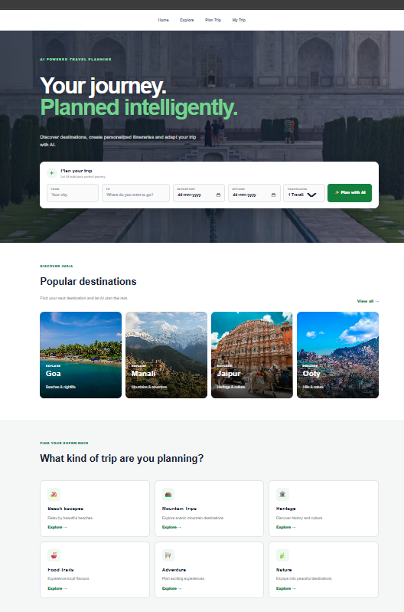
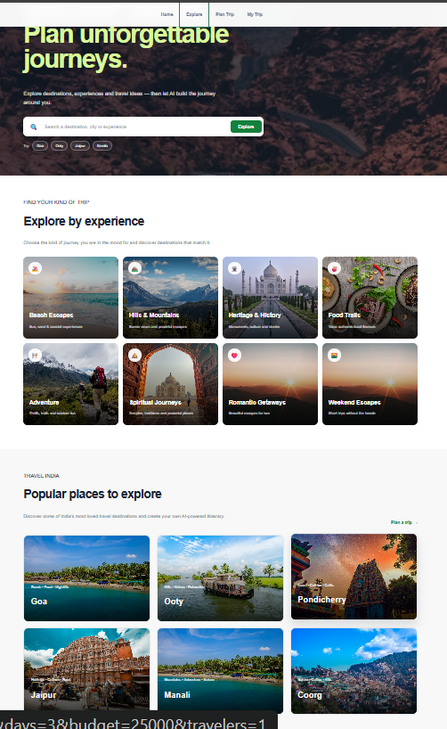
Project Title - AI Voyage Planner
Findings and Results

Slide 11
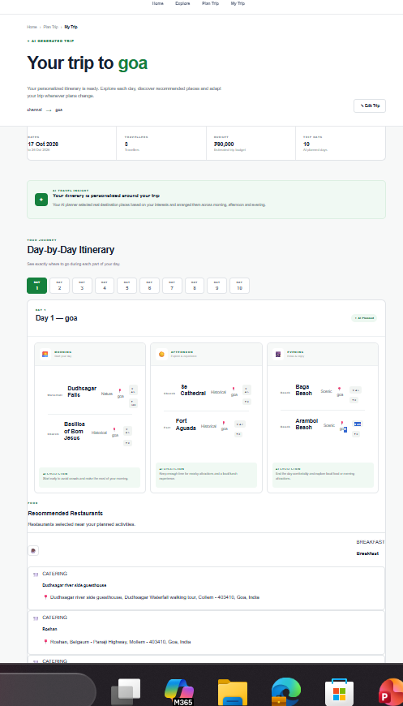
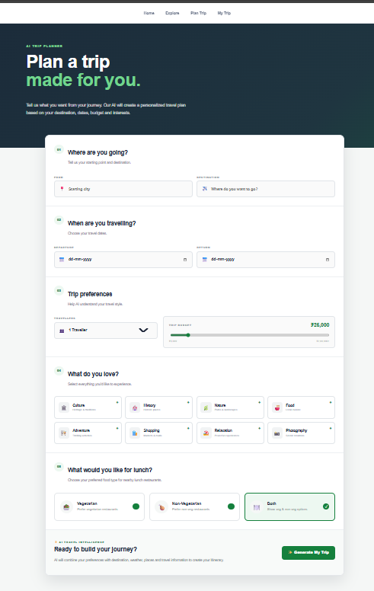
Project Title - AI Voyage Planner
Findings and Results

Slide 12
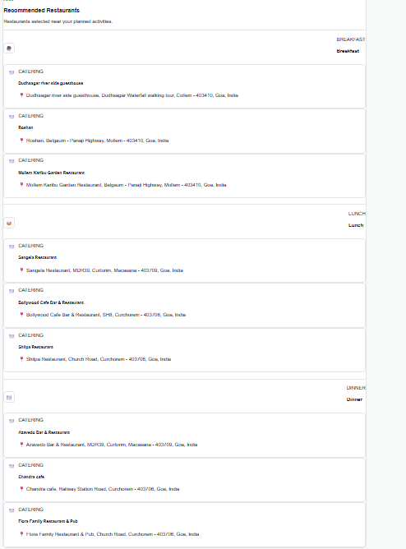
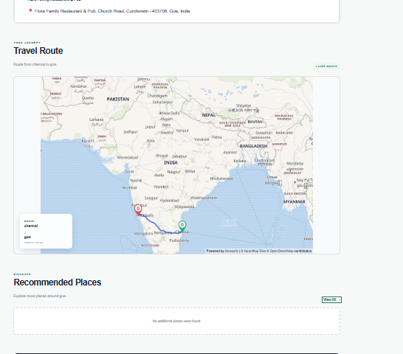
Project Title - AI Voyage Planner
Findings and Results

Slide 13
Limitation and Futurework
# | Dimension / Area | Current Limitation | Proposed Future Work & Solution | Expected Impact
1 | Geographic Scope | Limited primarily to destinations and POIs across India. | Expand knowledge base and RAG vector store to support global/international cities. | Transforms into a worldwide AI travel companion.
2 | Bookings & Reservations | Recommends places and hotels without direct booking or ticket checkout capabilities. | Integrate live booking APIs (Amadeus, Skyscanner, Booking.com, IRCTC, Uber/Ola). | Enables seamless, 1-click booking of flights, hotels, trains, and cabs within the itinerary.
3 | Pricing & Budgeting | Costs are estimated based on historical averages and heuristic price tiers. | Connect real-time dynamic pricing APIs for flights, hotels, and seasonal attraction tickets. | Delivers hyper-accurate, real-time budget forecasting and price surge alerts.
4 | Transit & Routing | Single-mode routes calculated without live traffic congestion or delay factors. | Implement multi-modal transit engine (Flight + Train + Metro + Cab) with live traffic integration. | Provides precise transit times, optimal route combinations, and carbon-aware travel choices.
5 | Offline Accessibility | Requires an active internet connection to generate itineraries and render maps. | Develop a Mobile App (React Native / PWA) with offline vector maps and local caching. | Guarantees uninterrupted access in remote travel zones or areas with poor network coverage.
6 | Group Collaboration | Itineraries are generated for single-user sessions with no shared editing features. | Implement real-time WebSockets for multi-user shared trip planning boards and voting. | Allows friends and family to co-create itineraries and vote on places collaboratively.
7 | Expense Tracking | No on-trip expense logging or group bill splitting features. | Build an in-trip expense manager with receipt scanning (OCR) and automated bill splitting. | Eliminates the need for external finance apps during group trips.
8 | Language & Accessibility | UI and AI outputs are currently restricted to English. | Add multi-lingual support (Hindi, Tamil, Telugu, etc.) and a hands-free AI voice assistant. | Enhances accessibility for diverse traveler demographics and enables audio-guided tours.
9 | On-Ground Experience | Recommendations are static cards without interactive on-site guidance. | Introduce GPS-fenced Augmented Reality (AR) wayfinding and AI historical audio narration. | Provides rich, interactive storytelling when tourists arrive at monuments and heritage sites.

Slide 14
Project Title - AI Voyage Planner
Conclusion
The AI Voyage Planner provides an intelligent and personalized approach to travel planning by combining Generative AI, Retrieval-Augmented Generation (RAG), and real-time travel data. The system uses user preferences such as destination, travel dates, budget, interests, number of travelers, and food preferences to generate customized day-wise itineraries. By integrating Geoapify for places, restaurants, hotels and route information and OpenWeather for weather details, the system provides practical and relevant travel recommendations. The smart itinerary module organizes activities into morning, afternoon, and evening schedules, while the dynamic replanning feature allows the itinerary to be updated according to changing travel conditions and user requirements. Overall, the proposed system reduces the complexity of manual travel planning and provides a flexible, personalized, and intelligent travel experience.

Slide 15
Project Title - AI Voyage Planner
Acknowledgement
I sincerely thank LTM and L&T EduTech for providing the infrastructure, laptop, training room, ID card, and a valuable 2-month opportunity to enhance my technical skills through practical project development.
I express my special gratitude to Dr. Ganesh for his continuous guidance, valuable suggestions, and support in improving my project. I also thank the Classroom Managers for their daily monitoring, coordination, and assistance in resolving issues. Finally, my special thanks to Mr. Jayakanthan, Manager – Delivery Operations, L&T EduTech, for his encouragement, support, and for providing this valuable opportunity.

Slide 16
Project Title - AI Voyage Planner
Reference
[1] H. Zheng et al., “Recommender Systems in the Era of Large Language Models (LLMs),” IEEE Transactions on Knowledge and Data Engineering, vol. 36, no. 11, pp. 6889–6907, Nov. 2024, doi: 10.1109/TKDE.2024.3392335.
[2] “Travel Itinerary Generation using AI and Recommendation Systems,” in Proc. IEEE Conf., 2025.
[3] “Smart Trip Planner for Personalized Tourism Itineraries,” in Proc. 5th Int. Conf. on Ubiquitous Computing and Intelligent Information Systems (ICUIS), 2025, doi: 10.1109/ICUIS67429.2025.11380545.
[4] “Genetic Algorithm Based Personalized Travel Recommendation System,” in Proc. 2nd Int. Conf. on Intelligent Data Communication Technologies and Internet of Things (IDCIoT), 2024, doi: 10.1109/IDCIoT59759.2024.10467470.
[5] “Evaluation of the Effect of Tourism Recommendation System based on AI,” in Proc. 3rd Int. Conf. on Artificial Intelligence and Computer Information Technology (AICIT), 2024, doi: 10.1109/AICIT62434.2024.10730422.

